Slide 1
HASHING: COLLISION RESOLUTION SCHEMES
Collision Resolution Techniques
Separate Chaining
Separate Chaining with String Keys
Separate Chaining versus Open-addressing
The class hierarchy of Hash Tables
Implementation of Separate Chaining
Introduction to Collision Resolution using Open Addressing
Linear Probing

Slide 2
COLLISION RESOLUTION TECHNIQUES
There are two broad ways of collision resolution:
1. Separate Chaining:: An array of linked list implementation.
2. Open Addressing: Array-based implementation.
  (i) Linear probing (linear search)
  (ii) Quadratic probing (nonlinear search)
  (iii) Double hashing (uses two hash functions)

Slide 3
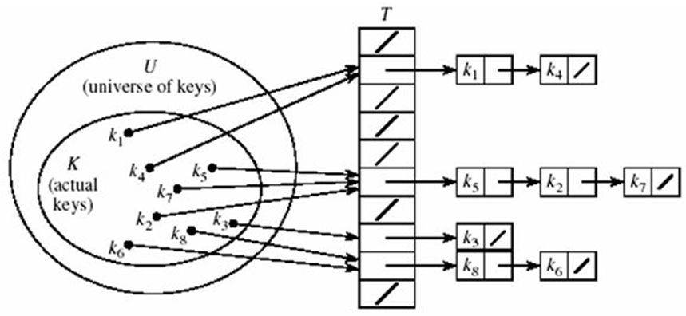
SEPARATE CHAINING
The hash table is implemented as an array of linked lists.
Inserting an item, r, that hashes at index i is simply insertion into the linked list at position i.
Synonyms are chained in the same linked list.

Slide 4
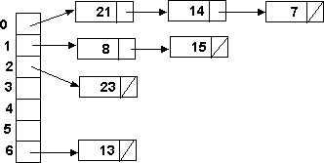
SEPARATE CHAINING (CONT’D)
Retrieval of an item, r, with hash address, i, is simply retrieval from the linked list at position i.
Deletion of an item, r, with hash address, i, is simply deleting r from the linked list at position i.
Example: Load the keys 23, 13, 21, 14, 7, 8, and 15 , in this order, in a hash table of size 7 using separate chaining with the hash function: h(key) = key % 7
h(23) = 23 % 7 = 2
h(13) = 13 % 7 = 6
h(21) = 21 % 7 = 0
h(14) = 14 % 7 = 0 collision
h(7) = 7 % 7 = 0 collision
h(8) = 8 % 7 = 1
h(15) = 15 % 7 = 1 collision

Slide 5
SEPARATE CHAINING WITH STRING KEYS (CONT’D)
Use the hash function hash to load the following commodity items into a hash table of size 13 using separate chaining:
    onion 1 10.0
    tomato 1 8.50
    cabbage 3 3.50
    carrot 1 5.50
    okra 1 6.50
    mellon 2 10.0
    potato 2 7.50
    Banana 3 4.00
    olive 2 15.0
    salt 2 2.50
    cucumber 3 4.50
    mushroom 3 5.50
    orange 2 3.00
Solution:
hash(onion) = (111 + 110 + 105 + 111 + 110) % 13 = 547 % 13 = 1
hash(salt) = (115 + 97 + 108 + 116) % 13 = 436 % 13 = 7
hash(orange) = (111 + 114 + 97 + 110 + 103 + 101)%13 = 636 %13 = 12

Slide 6
SEPARATE CHAINING WITH STRING KEYS (CONT’D)
0
1
2
3
4
5
6
7
8
9
10
11
12
okra
potato
onion
carrot
Item Qty Price h(key)
onion 1 10.0 1
tomato 1 8.50 10
cabbage 3 3.50 4
carrot 1 5.50 1
okra 1 6.50 0
mellon 2 10.0 10
potato 2 7.50 0
Banana 3 4.0 11
olive 2 15.0 10
salt 2 2.50 7
cucumber 3 4.50 9
mushroom 3 5.50 6
orange 2 3.00 12
cabbage
mushroom
salt
cucumber
tomato
mellon
olive
banana
orange

Slide 7
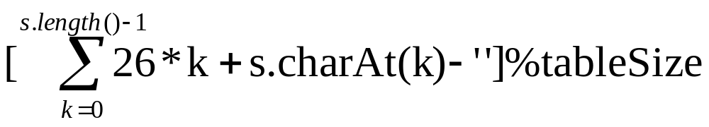
SEPARATE CHAINING WITH STRING KEYS (CONT’D)
Alternative hash functions for a string
s = c₀c₁c₂…c_{n-1}
exist, some are:
hash = (c₀ + 27 * c₁ + 729 * c₂) % tableSize
hash = (c₀ + c_{n-1} + s.length()) % tableSize
hash =

Slide 8
SEPARATE CHAINING VERSUS OPEN-ADDRESSING
Separate Chaining has several advantages over open addressing:
Collision resolution is simple and efficient.
The hash table can hold more elements without the large performance deterioration of open addressing (The load factor can be 1 or greater)
The performance of chaining declines much more slowly than open addressing.
Deletion is easy - no special flag values are necessary.
Table size need not be a prime number.
The keys of the objects to be hashed need not be unique.
Disadvantages of Separate Chaining:
It requires the implementation of a separate data structure for chains, and code to manage it.
The main cost of chaining is the extra space required for the linked lists.
For some languages, creating new nodes (for linked lists) is expensive and slows down the system.

Slide 9
INTRODUCTION TO OPEN ADDRESSING
All items are stored in the hash table itself.
In addition to the cell data (if any), each cell keeps one of the three states: EMPTY, OCCUPIED, DELETED.
While inserting, if a collision occurs, alternative cells are tried until an empty cell is found.
Deletion: (lazy deletion): When a key is deleted the slot is marked as DELETED rather than EMPTY otherwise subsequent searches that hash at the deleted cell will fail.
Probe sequence: A probe sequence is the sequence of array indexes that is followed in searching for an empty cell during an insertion, or in searching for a key during find or delete operations.
The most common probe sequences are of the form:
h_{i}(key) = [h(key) + c(i)] % n, for i = 0, 1, …, n-1.
where h is a hash function and n is the size of the hash table
The function c(i) is required to have the following two properties:
Property 1: c(0) = 0
Property 2: The set of values {c(0) % n, c(1) % n, c(2) % n, . . . , c(n-1) % n} must be a permutation of {0, 1, 2,. . ., n – 1}, that is, it must contain every integer between 0 and n - 1 inclusive.

Slide 10
INTRODUCTION TO OPEN ADDRESSING (CONT’D)
The function c(i) is used to resolve collisions.
To insert item r, we examine array location h₀(r) = h(r). If there is a collision, array locations h₁(r), h₂(r), ..., h_{n-1}(r) are examined until an empty slot is found.
Similarly, to find item r, we examine the same sequence of locations in the same order.
Note: For a given hash function h(key), the only difference in the open addressing collision resolution techniques (linear probing, quadratic probing and double hashing) is in the definition of the function c(i).
Common definitions of c(i) are:
Collision resolution technique | c(i)
Linear probing | i
Quadratic probing | ±i²
Double hashing | i*h_{p}(key)
where h_{p}(key) is another hash function.

Slide 11
INTRODUCTION TO OPEN ADDRESSING (CONT'D)
Advantages of Open addressing:
  All items are stored in the hash table itself. There is no need for another data structure.
  Open addressing is more efficient storage-wise.
Disadvantages of Open Addressing:
  The keys of the objects to be hashed must be distinct.
  Dependent on choosing a proper table size.
  Requires the use of a three-state (Occupied, Empty, or Deleted) flag in each cell.

Slide 12

OPEN ADDRESSING FACTS
In general, primes give the best table sizes.
With any open addressing method of collision resolution,
as the table fills, there can be a severe degradation in the table performance.
Load factors between 0.6 and 0.7 are common.
Load factors > 0.7 are undesirable.
The search time depends only on the load factor, not on the table size.
We can use the desired load factor to determine appropriate table size:

Slide 13
OPEN ADDRESSING: LINEAR PROBING
c(i) is a linear function in i of the form c(i) = a*i.
Usually c(i) is chosen as:
c(i) = i for i = 0, 1, . . . , tableSize – 1
The probe sequences are then given by:
h_{i}(key) = [h(key) + i] % tableSize for i = 0, 1, . . . , tableSize – 1
For c(i) = a*i to satisfy Property 2, a and n must be relatively prime.

Slide 14
LINEAR PROBING (CONT’D)
Example: Perform the operations given below, in the given order, on an initially empty hash table of size 13 using linear probing with c(i) = i and the hash function: h(key) = key % 13:
insert(18), insert(26), insert(35), insert(9), find(15), find(48), delete(35), delete(40), find(9), insert(64), insert(47), find(35)
The required probe sequences are given by:
h_{i}(key) = (h(key) + i) % 13 i = 0, 1, 2, . . ., 12

Slide 15
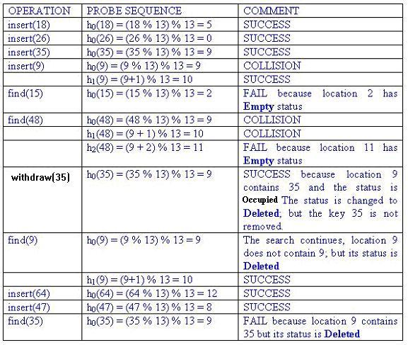
A
Linear Probing (cont’d)
Index | Status | Value
0 | O | 26
1 | E
2 | E
3 | E
4 | E
5 | O | 18
6 | E
7 | E
8 | O | 47
9 | D | 35
10 | O | 9
11 | E
12 | O | 64

Slide 16
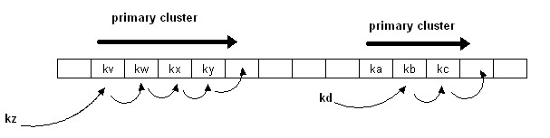
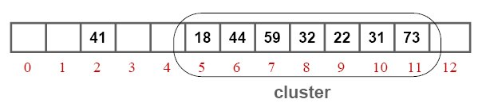
DISADVANTAGE OF LINEAR PROBING: PRIMARY CLUSTERING
Linear probing is subject to a primary clustering phenomenon.
Elements tend to cluster around table locations that they originally hash to.
Primary clusters can combine to form larger clusters. This leads to long probe
sequences and hence deterioration in hash table efficiency.
Example of a primary cluster: Insert keys: 18, 41, 22, 44, 59, 32, 31, 73, in this order, in an originally empty hash table of size 13, using the hash function h(key) = key % 13 and c(i) = i:
h(18) = 5
h(41) = 2
h(22) = 9
h(44) = 5+1
h(59) = 7
h(32) = 6+1+1
h(31) = 5+1+1+1+1+1
h(73) = 8+1+1+1

